Slide 1

Boosting algorithm_regression
by
-Swathi Sekar

Slide 2
BOOSTING
Boosting refers to the process of creating a strong learner from a collection of weak learners.
Types of Boosting Algorithms:
AdaBoost (Adaptive Boosting)
XGBoost (Extreme Gradient Boosting)
LightGBM (Light Gradient Boosting Machine)

Slide 3
1.ADA BOOST
Ensemble method in Machine Learning.
It is a boosting technique that builds a final model from the sum of several weak learning algorithms that were trained on the same dataset.
Reassign weight to each instance.
Higher weight for incorrectly classified.
Reduces bias and varience.

Slide 4
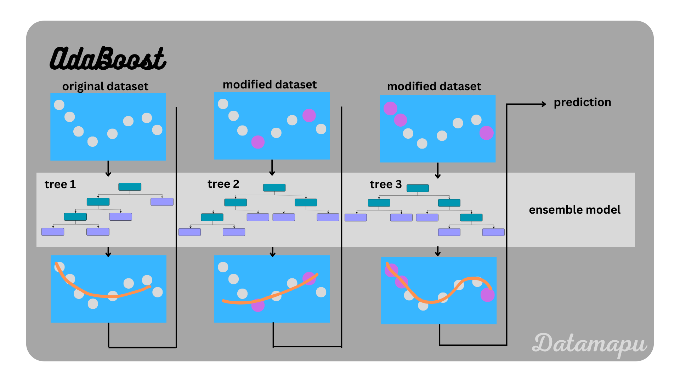

Slide 5
2.XG BOOSTING
XGBoost stands for “Extreme Gradient Boosting”
XGBoost is a type of gradient boosting model that uses tree-building techniques to predict its final value.
It usually requires extra tuning to reach peak performance.

Slide 6
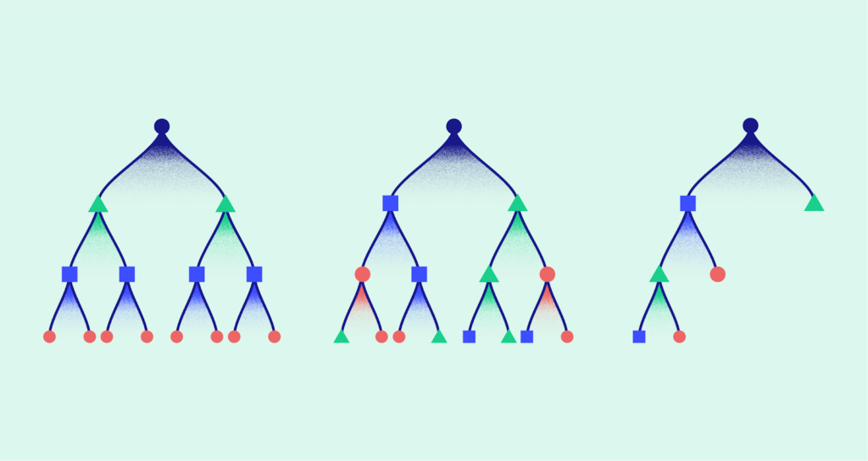

Slide 7
3.LG BOOSTING
LightGBM uses a technique called gradient boosting, which combines multiple weak learners (usually decision trees) to create a strong predictive model.

Slide 8
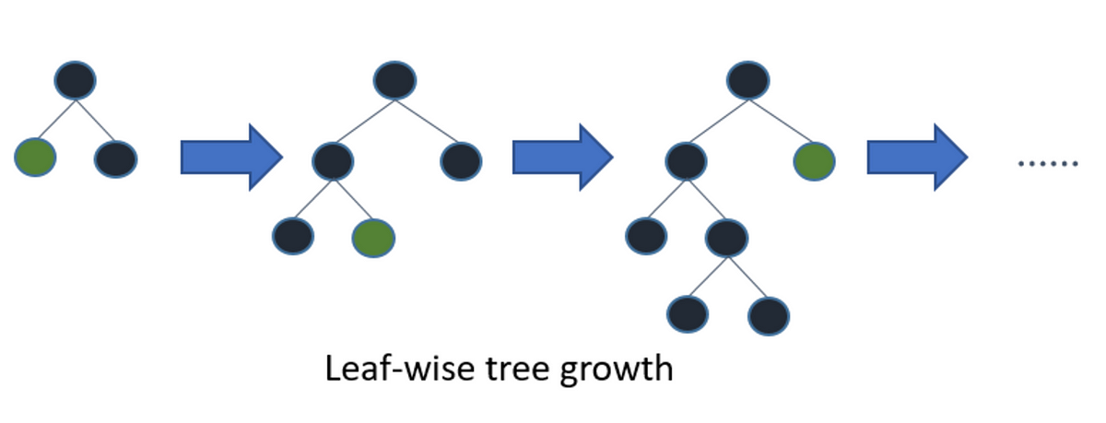

Slide 9

Thank You!
someone@example.com

